Slide 1
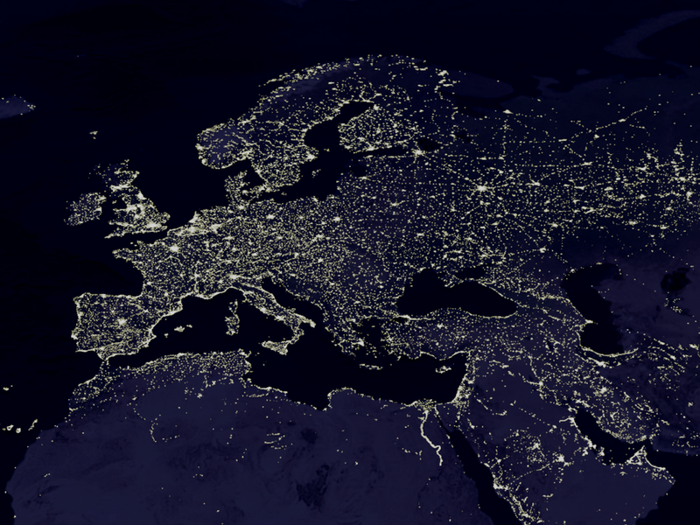
EUROPE PRAYER SUNDAY
PENTECOSTAL EUROPEAN
FELLOWSHIP

Slide 2
Eastern Europe
Religious freedom in Russia and Belarus.
Peace in Ukraine.

Slide 3
Northern Europe
LITHUANIA
Next generation of leaders
Renewal and fullness of the Holy Spirit
Faith to reach the lost
Vision to have 150 churches throughout the country by 2035
Workers for the Lord’s Harvest

Slide 4
Western Europe
BELGIUM
Spiritual unity and Pentecostal revival
Church planting projects in Walloon region
UNITED KINGDOM
Consequences of Brexit
Pentecostals to take a stand against racism
Unity of Pentecostal movements with the rest of Europe
IRELAND
Pro-Life movement in abortion debate

Slide 5

Missions’ Offering for Europe
This year’s collection will be used for PEF’s next summer outreach in Montenegro

Slide 6
Central Europe
Pentecostal Revival and church planting in
the Principality of Liechtenstein,
one of the smallest countries in the world,
between Switzerland and Austria.

Slide 7
Southern Europe
GREECE
Openness from authorities for the preaching of the Gospel
GREECE-ITALY-MALTA-TURKEY
Works among refugees

Slide 8
Balkans
SLOVENIA, CROATIA, BOSNIA AND HERZEGOVINA, SERBIA, MONTENEGRO, KOSOVO, MACEDONIA
Revival, serious church growth
Unity (breaking of Ethnic ‘walls’)
New generation of leaders and God’s protection on his few servants
2017 Impact Montenegro
BULGARIA
Presidential election today

